Slide 1
Metagenomic Analysis of eDNA Samples from the Klamath Mountains
Eric Beraut
3/8/19

Slide 2
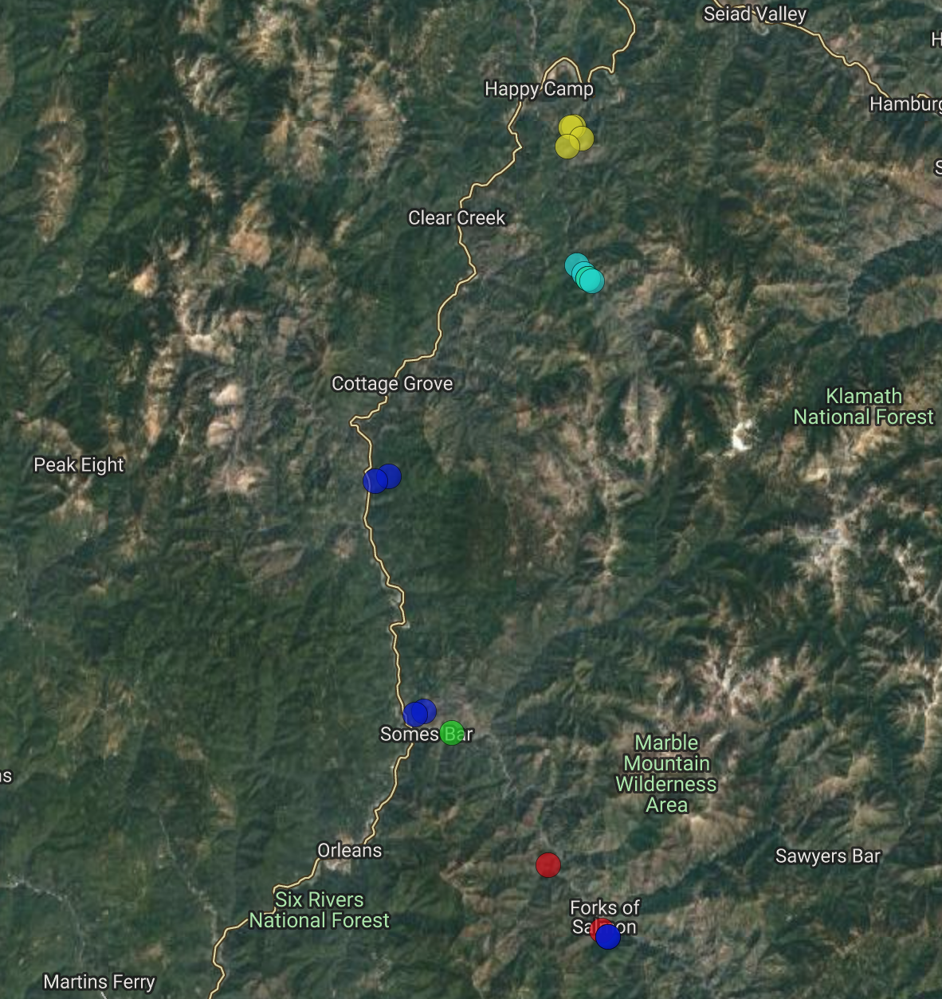
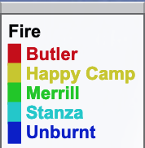
Introduction
18 Samples
Fires
Butler: 2 (2013)
Happy Camp: 4 (2014)
Merrill: 2 (2008)
Stanza : 4 (2002)
Unburnt: 6
Notes:
Received samples from a phd student from Davis . Chris Adlam studying the effect of wildfires on biodiversity

Slide 3
Research Questions
Does Fire increase species richness?
Does Fire change community composition?
Which kinds of organismal communities are driven to change by fire?
Are there specific taxonomic groups affected by fire?
Are these taxa relevant in our network?

Slide 4
Methods: Lab work
1. DNA extraction from soil samples
2. Run three PCR reactions for each of five primers
3. Pool PCR’s and purify using magnetic beads
4. Run a PCR to add unique index’s to each sample
5. Send samples to be sequenced
6. Receive Sequence data: Begin Analysis

Slide 5
Primer overview
16S
Targets Bacteria and Archaea
18S
Eukaryotes
CO1
Invertebrates
FITS
Fungi
PITS
Plants
Notes:
Genetix Barcode which allows us to identify communities at higher taxonomic levels. Fire might influence all of these groups differently so its important to analyze separately

Slide 6
Results: Does Fire increase species richness?
16S
18S
CO1
PITS
FITS
Notes:
Simple answer, no. Almost none of the primers show a significant change in species richness between the unburnt and the burnt. Only the fungal community of the stanza fire had an increase in species richness

Slide 7
Does Fire increase species richness?
FITS
Notes:
Lose two samples from rarefaction. Its hard to tell if fire drives the increase or if the increase is just because it is a geographic unique group. I don’t enough samples to make a conclusion about this

Slide 8
Does Fire change community composition?
18S
PITS
Notes:
Summarized to Family: No real pattern, Not a lot of consistency between samples or groups.

Slide 9
Does Fire change community composition?
CO1
FITS
Notes:
Start to see a little grouping by fire. No distinct difference between fire and unburnt

Slide 10
16S
Notes:
16S has what looks like very stable community compositions. The unburnt looks very similar to all the burnt

Slide 11
Does Fire change community composition?
unburnt
burnt
16S
18S
CO1
Notes:
Two baseline groups among my samples. Within each of these, there is a lot of variation along axis two for bacteria. Animate with box around unburnt and burnt

Slide 12
Does Fire change community composition?
unburnt
burnt
FITS
PITS

Slide 13
Bacterial Communities
16S
Notes:
16S is the biggest and most stable dataset I had, grouped as shown

Slide 14
PITS: Colored by Fire
PITS: Colored by Bacterial Groups
Notes:
Pits is more correlated with the bacterial community than it is with the Fire. Bacteria is related to fire, plants is related to bacteria. Wish I had more samples to see what is most related

Slide 15
Are there specific taxonomic groups affected by fire?
16S
Acidobacteriaceae
Present in the rhizosphere microbiome of oak trees (González et al.)
Responsive to fire (Cutler et al.)

Slide 16
Are there specific taxonomic groups affected by fire?
16S
Acidobacteriaceae
(years)
Notes:
We see a trend of variation decreasing after fire, increasing after a long period of time. Need more samples to actually look at trends

Slide 17
Are there specific taxonomic groups affected by fire?
Present
Not Present
unburnt
burnt
16S: Arthrobacter Presence
FITS: Cadophora Presence
FITS: Rhizopogon Presence
Notes:
Looked at genera next. Saw a bit of grouping, not a lot. Need more samples to say anything

Slide 18
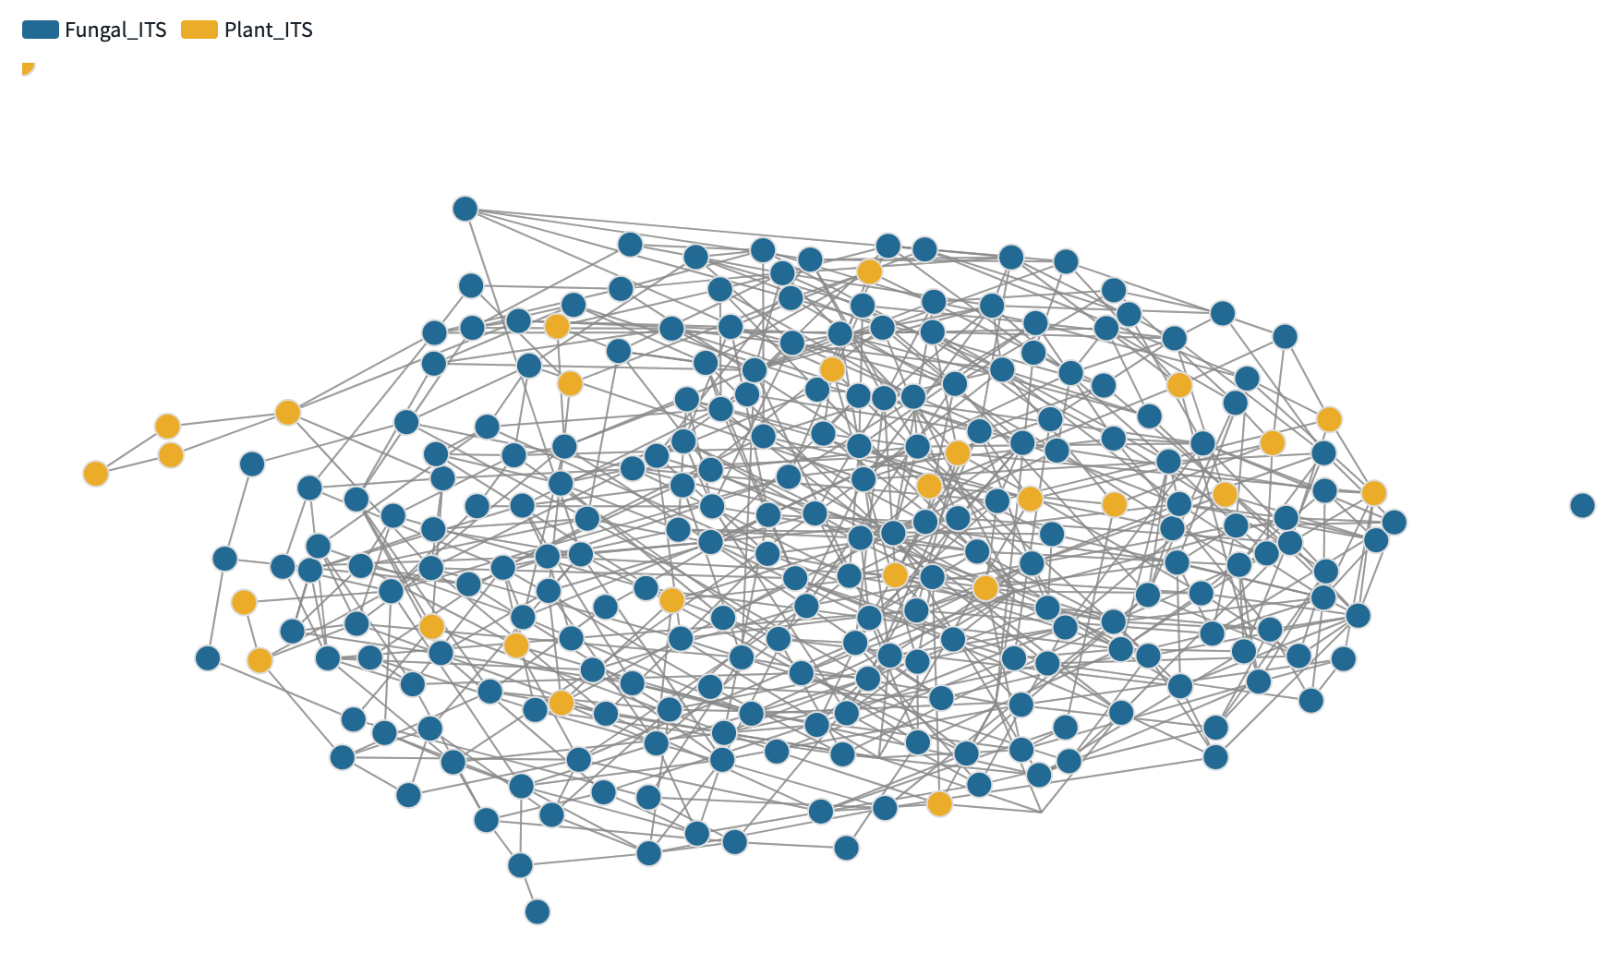
Are these taxa relevant in our network?

Slide 19
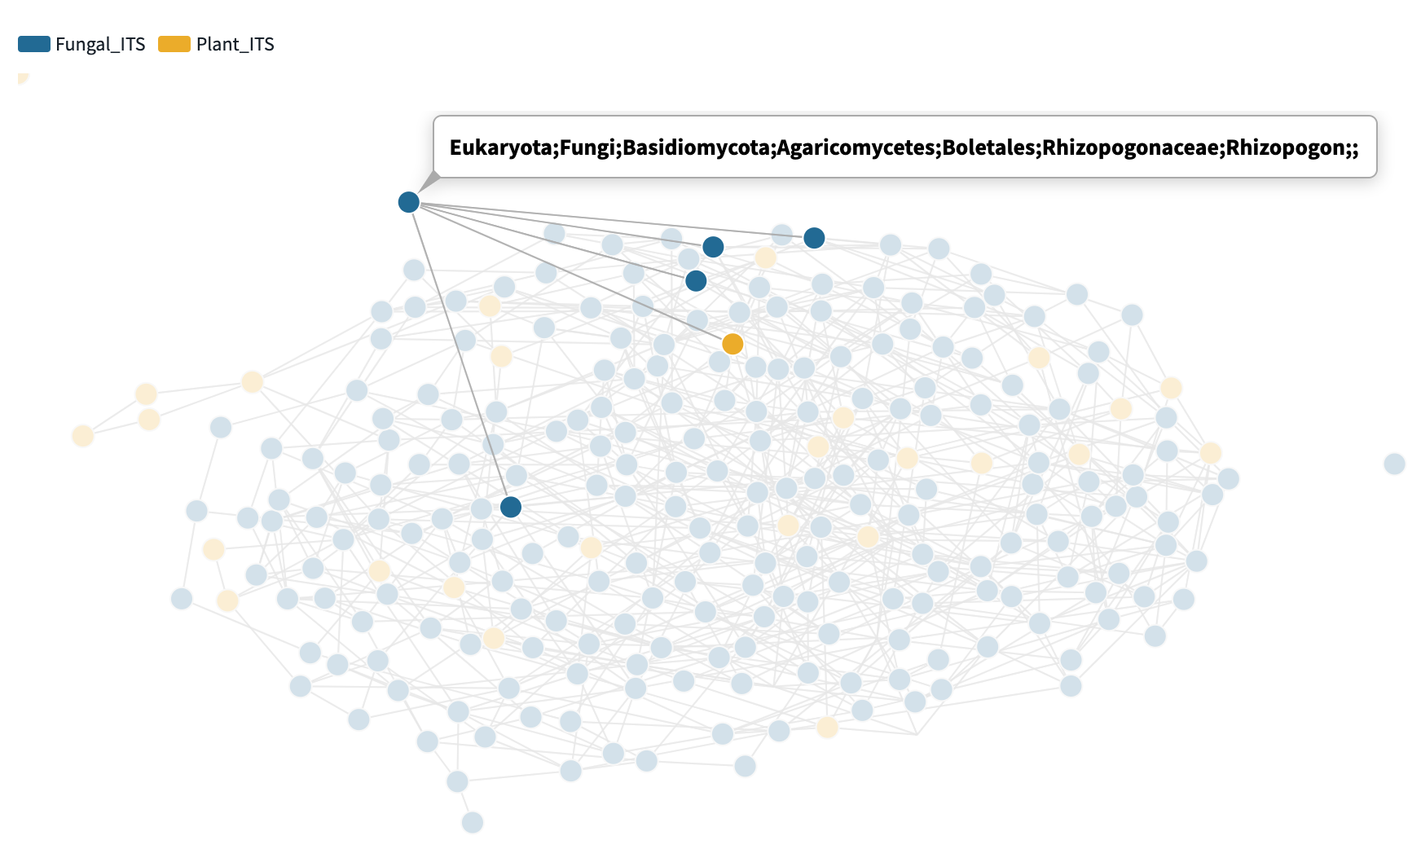
Are these taxa relevant in our network?
Notes:
Chose rhizopogon because the literature I read said it was important for microbial communities after fire

Slide 20
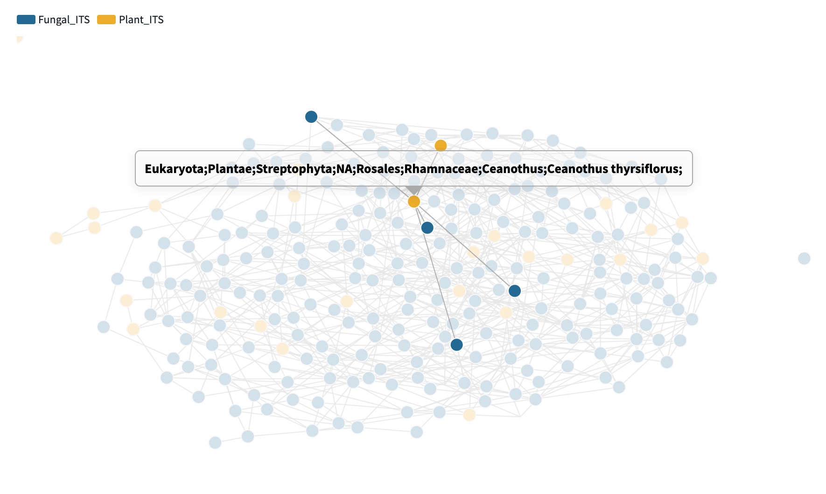
Are these taxa relevant in our network?
Ceanothus
Shown to dominate post fire mixed evergreen sites for decades (Davis et al.)
Often lives with and around oak
Notes:
Ceanothus is a nitrogen fixing shrub commonly found in oak communities. Has been shown to dominate post fire sites for decades

Slide 21
References
Cutler, Nick A., et al. “Long-Term Recovery of Microbial Communities in the Boreal Bryosphere Following Fire Disturbance.” SpringerLink, Springer US, 18 Aug. 2016, link.springer.com/article/10.1007/s00248-016-0832-7.
Davis, Frank W. “Pre-Impact Forest Composition and Ongoing Tree Mortality Associated with Sudden Oak Death in the Big Sur Region; California.” Forest Ecology and Management, Elsevier, 15 Apr. 2010, www.sciencedirect.com/science/article/pii/S0378112710001532.
Fernández-González, Antonio J., et al. “The Rhizosphere Microbiome of Burned Holm-Oak: Potential Role of the Genus Arthrobacter in the Recovery of Burned Soils.” Nature News, Nature Publishing Group, 20 July 2017, www.nature.com/articles/s41598-017-06112-3.
Fierer, Noah. “Embracing the Unknown: Disentangling the Complexities of the Soil Microbiome.” Nature News, Nature Publishing Group, 21 Aug. 2017, www.nature.com/articles/nrmicro.2017.87#df5.
Glassman, Sydney I, et al. “Ectomycorrhizal Fungal Spore Bank Recovery after a Severe Forest Fire: Some like It Hot.” Nature News, Nature Publishing Group, 16 Oct. 2015, www.nature.com/articles/ismej2015182#s1.

